Slide 1
Calculating Compliance Income

Slide 2
Special Rules for the NC 1st Home Advantage Program
Funds are Available in all 100 NC Counties
New or Existing Properties
Must be First Time Home Buyer or Meet Exceptions
Sales Price Limit is currently $490,000 Statewide
Income Limits Apply and Vary Based on the County and # of Occupants

Slide 3
Family Income Limits Apply
For the current income limits go to:
https://www.nchfa.com/home-buyers/income-limits

Slide 4
What is Family Income?
All of the income received by All borrowers, spouses,
& owner occupants must be considered.
Base Pay
Commission
Bonus, Overtime, Auto Allowance
Self Employment Income
Interest, Dividends, Annuities
Pension, Social Security, Unemployment, Workers Comp, VA benefits
Child & Spousal Support
Government Subsidies (Section 8, AFDC)
Gross Rental Income
Deferred Income
All other regularly occurring additional income
Other as applicable
Not all inclusive. Check Program Guide for other types of Compliance Income.

Slide 5
Updated April 2025. Subject to change. Refer to Program Guidelines for detailed information

Slide 6
Disclosure of Income
Lenders should always ask the borrowers and/or titleholders to disclose their current base income (before any payroll deductions). Current base income includes income from primary and part-time jobs and all other income that the borrowers receive at the time the lender submits loan documents for NCHFA approval. This income is used for compliance underwriting purposes.
All income is projected for 12 months to calculate compliance income; regardless of its likelihood to continue.

Slide 7
Documentation the Agency will Review
Three years signed Federal Tax Returns or Transcripts
Paystubs must be dated within 45 days of submission to NCHFA (per payroll ending date) clearly indicating base income as well as other sources of income such as bonus, over-time, commission, shift differential, etc.
Verifications of Employment – Verbal or Written for all W2s from the previous year
The sum of all W2s must match the amount reported on the tax return
Copies of any additional income such as child support, alimony, pension, social security, VA compensation and/or pension, interest, etc.*
YTD Profit and Loss if Self-Employed – must be signed by the borrower
Business Use Worksheet if Self-Employed – this form is found on our website
*Please note the sources of income listed above
are not all inclusive so always check the Individual Program Guide for a complete list.

Slide 8
Prior Employment or New Employment
For borrowers quitting or resigning from a job, a resignation letter and verification from prior employer must be dated, signed, and acknowledged by former employer prior to submission of underwriting file to NCHFA. If borrower is starting a new job, then we must have copy of resignation letter and proof of acceptance from prior employer, otherwise income from both jobs with be used in calculating gross, family income.
For borrowers starting a new job where a paycheck/paystub is not yet available, the lender must obtain a written VOE from employer along with a signed, valid offer letter from new employer that shows salary and start date. The Master Servicer, ServiSolutions, will require a paystub as part of the final closing package submitted after closing.

Slide 9
2025 Payroll Calendar

Slide 10
Calculating Base Pay for Wage Earners
Determine how often the Borrower/Occupant is Paid:
Weekly?
Bi-Weekly?
Bi-Monthly?
Monthly?

Slide 11
Calculating Base Pay for Wage Earners
Determine how the Borrower/Spouse/Title Holder is Paid:
Hourly? How Many hours per pay period?
Salary?
Overtime?
Bonus?

Slide 12
Calculating Base Pay for Wage Earners
Hourly Rate
X
Hours Per Pay Period
X
# of Pay Periods
=
Annual Base Pay

Slide 13
Calculating Overtime, Bonus, etc. for Wage Earners
January 1 to June 30: add the current base pay to any additional income (overtime, bonus, shift differential, commission, etc.) from last year and YTD and project the additional income for the remainder of the year. For new employment, we will average the current base pay and other income by the number of pay-periods they have worked.
July 1:* add the current base pay to any additional income (overtime, bonus, shift differential, etc.) from the current year only and project the additional income for the remainder of the year.*
All income in excess of Base Pay is considered “Other”
Total Income (Previous Year + YTD or YTD only) – Base Pay = Other Income
* For Full Time Wage Earners on the Same Job

Slide 14
Calculating Compliance Income for Wage Earners
Annual Base Pay
+
Other Income
=
Total Compliance Income

Slide 15
Calculating Income for Self-Employed Borrowers
Income will be averaged from the previous 2 years Federal Tax Returns + depreciation/depletion +YTD Profit and Loss.
If 2 years are not available then use previous year & YTD, or YTD if it is a new business.
The Profit and Loss may be self-prepared but needs to be signed by the borrower.
Losses are NOT deducted from Family Income. Any loss is reflected as “0” .

Slide 16
Calculating Self-Employed Income
Previous 2 years Federal Tax Returns
(Or last year and YTD or just YTD)
+
Depreciation/Depletion
+
YTD Profit and Loss
/
by # of months
=
Compliance Income

Slide 17
Totaling Family Compliance Income
After you have calculated Compliance Income for each Owner Occupant, add together. Don’t forget to add other sources of income, like interest, dividends, alimony, child support, etc.
Borrower 1 Compliance Income $_______
+
Borrower 2 Compliance Income $_______
+
Owner Occupant Compliance Income $_______
+
All other sources of Income Compliance Income $_______
=
Total Compliance Income $___________________

Slide 18
Example Income Calculation
Assume today is March 15, 2025
Borrower has been employed with the same employer for 3 years
Current income is $22.50 per hour; paid weekly
Received $2.00 per hour raise on November 3, 2024 (end of pay period 44)
Current pay stub dated March 8, 2025 (end of pay period 10) reflects YTD income of $11,240
W2 from 2023 reflects total income of $51,040.

Slide 19
How to Calculate Compliance Income from the Example
Previous Year Rate $20.50 x 40 per pay period x 44 pay periods (last year at old rate) = $36,080
New Rate for the remaining pay periods from last year $22.50 x 40 = $900 x 8 = $7200
$36,080 + $7,200 = $43,280 (base income for 2024) – W2 total income $51,040 = $7,760 (total other income for 2024)
2025 Base Income $22.50 x 40 hours = $900 per pay period x 52 weeks = $46,800 Total Annual Base
2025 YTD Income as of pay period 10 = $11,240. However, $900 x 10 pay periods would be $9,000 so $11,240 - $9,000 = $2,240 2024 other income
Past year Other $7,760 + YTD Other $2,240 = $10,000 total other income / 62 pay periods = $161.29 x 52 weeks = $8,837 total projected other income
$46,800 Base + $8,387 other income = $55,187 = Total Compliance Income

Slide 20
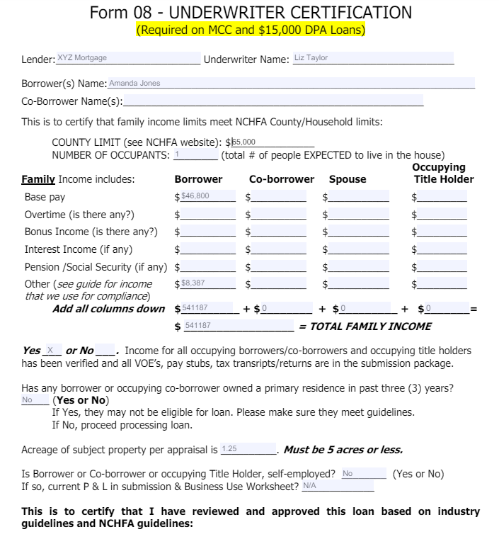
All sections of this form must be completed by the underwriter

Slide 21
Best Practice Reminders
Double Check that all information matches and is accurate BEFORE submitting your loan to the Agency for review.
Make sure to include the Business Use Worksheet for a self-employed borrower and that the YTD Profit and Loss Statement is signed by the borrower.
Follow the Submission Package Checklist (Page 2 of the Form 08) as a reminder of all required documentation and forms, as well as who is required to sign our forms.

Slide 22
Thank You! We look forward to helping you!
Contacts:
Margie Rivera, OLS/Lender Support: mbrivera@nchfa.com
Kathy Rufiange, Training & Outreach: kprufiange@nchfa.com
Bill Hobbs, Lender Liaison: wahobbs@nchfa.com
Donna Pruitt, Loan Production Coordinator: dmpruitt@nchfa.com
Janet Adams, Underwriter: jdadams@nchfa.com
Amanda Glasgow, Underwriter: ahglasgow@nchfa.com
Tara Hillman, Underwriter: tjhillmann@nchfa.com
Rajeshree Patel-Howard, Underwriter: rphoward@nchfa.com
Amber Smith, Underwriter/Team Lead: ansmith@nchfa.com
Nicole Wivell, Underwriter: nmwivell@nchfa.com
Jan Ott, MCC & Bond Closing Specialist: jlott@nchfa.com
Rob Rusczak, Manager Home Ownership: rob@nchfa.com

